Slide 1
Murach’s C# (8th Edition)
Chapter 11
How to debug an app

Slide 2
Objectives
Applied
Use the debugging techniques presented in this chapter to debug any unhandled exceptions or logical errors in the apps that you develop.
Knowledge
Describe the use of the Hot Reload feature.
Describe the differences between the three Step commands that you can use to control the execution of an app.
Describe the primary differences between the Autos window, the Locals window, and the Watch window.
Describe the use of the Immediate window.
Explain how you can use the Debug class to display information in the Output window.

Slide 3
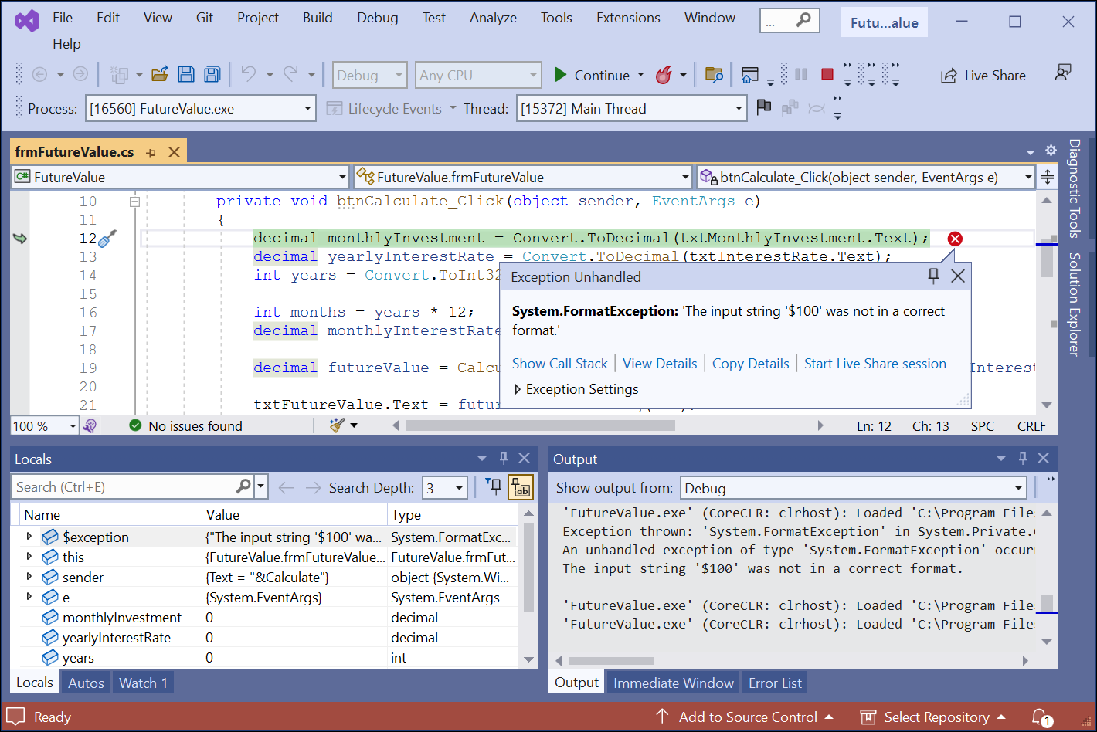
The Future Value app in break mode

Slide 4
Four ways to enter break mode
Force an unhandled exception to be thrown.
Set a breakpoint and run the app.
Choose the Debug→Step Into command or press F11.
Choose the Debug→Break All command or press Ctrl+Alt+Break while the app is executing.

Slide 5
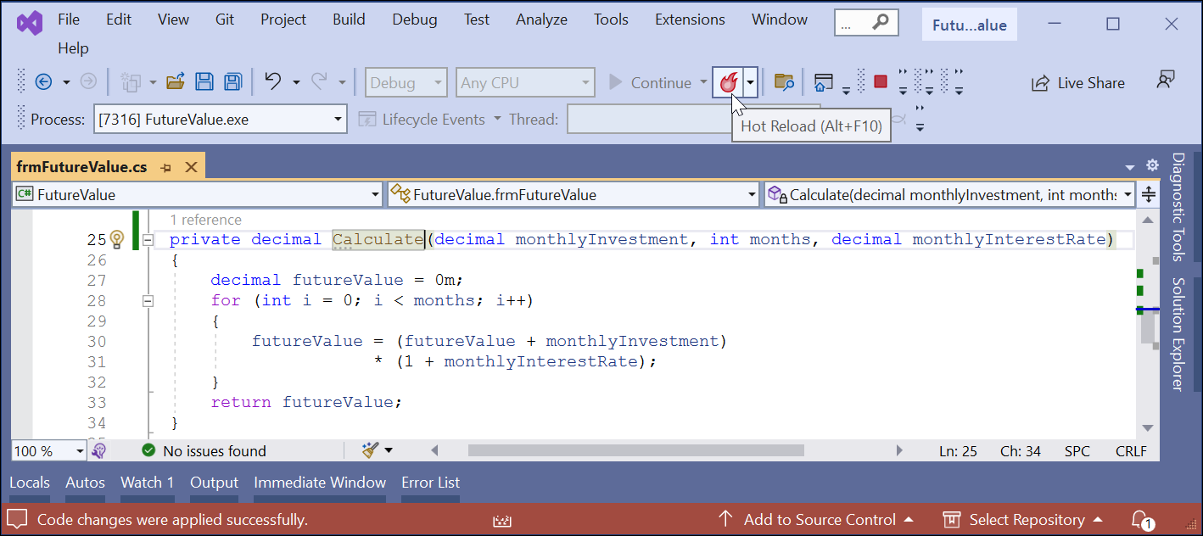
The Future Value app with a change being made while it’s running

Slide 6
How to use Hot Reload
Hot Reload lets you apply changes to an app while it’s running without restarting the app.
To do that, save the changes and click the Hot Reload button in the Standard toolbar.

Slide 7
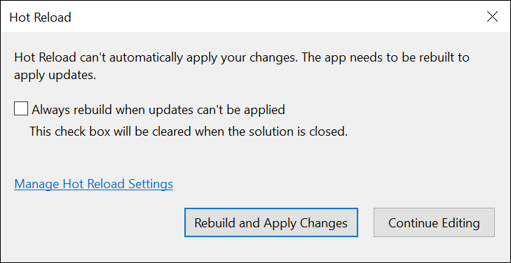
The dialog that’s displayed if Hot Reload can’t make a change

Slide 8
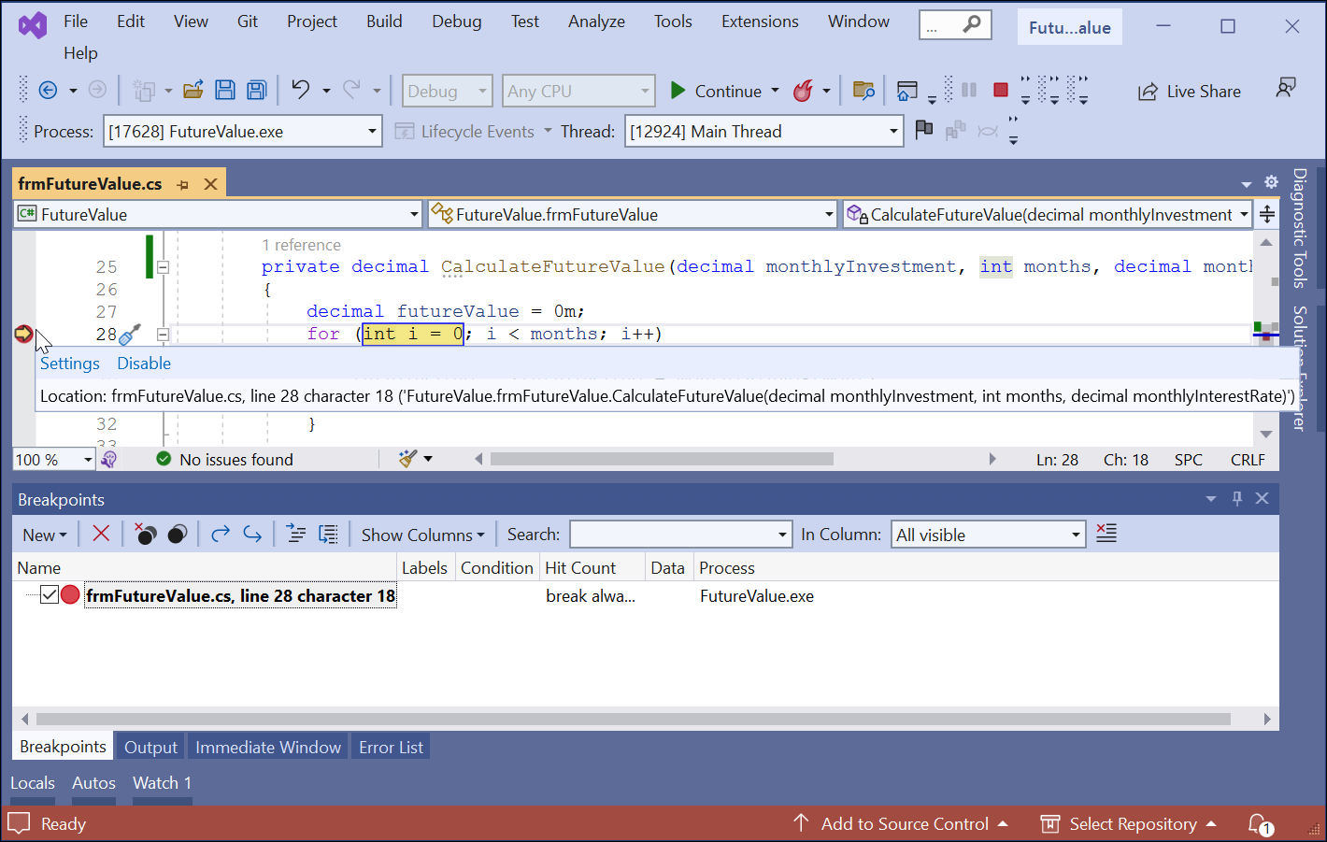
The Future Value app with a breakpoint

Slide 9
How to set and clear breakpoints
You can set a breakpoint before you run an app or while the app is in break mode.
To set a breakpoint, click in the margin indicator bar to the left of a statement. Or, press the F9 key.
To remove a breakpoint, use any of the techniques for setting a breakpoint.
To remove all breakpoints at once, use the Debug→Delete All Breakpoints command.
To disable all breakpoints, use the Debug→Disable All Breakpoints command.
To enable all breakpoints, use the Debug→Enable All Breakpoints command.

Slide 10
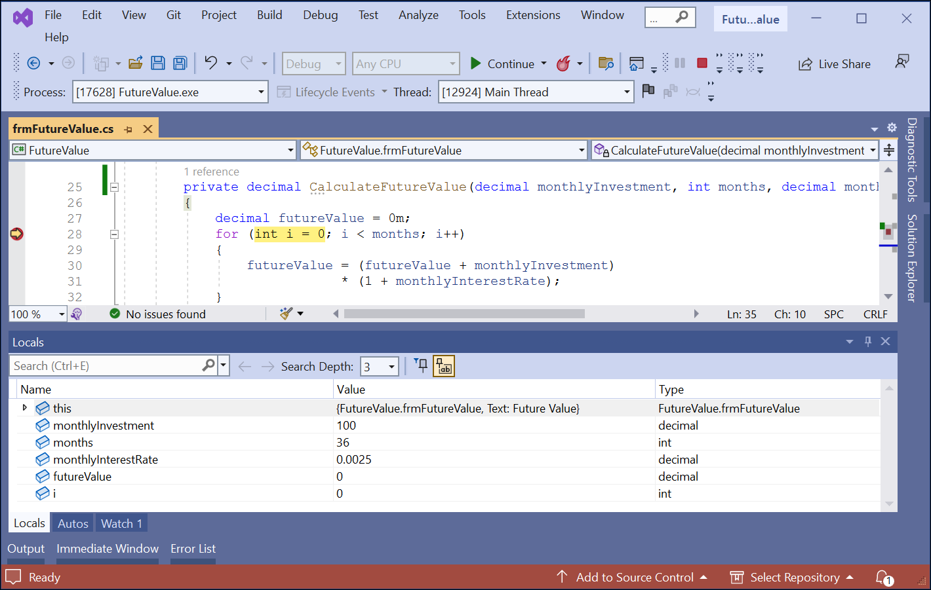
The Locals window

Slide 11
How to use the Locals window
The Locals window displays information about the variables within the current scope.
If you click on the  symbol to the left of the this keyword, the properties and variables of the form are displayed.
To change the value of a property or variable, double-click on the value in the Value column, type a new value, and press Enter.
With Visual Studio 2019 and later, you can search for values and objects in the Locals windows, and you can specify the number of levels deep you want to search.

Slide 12
How to use the Autos window
The Autos window works like the Locals window.
However, it only displays information about variables used by the current statement and the previous statement.

Slide 13
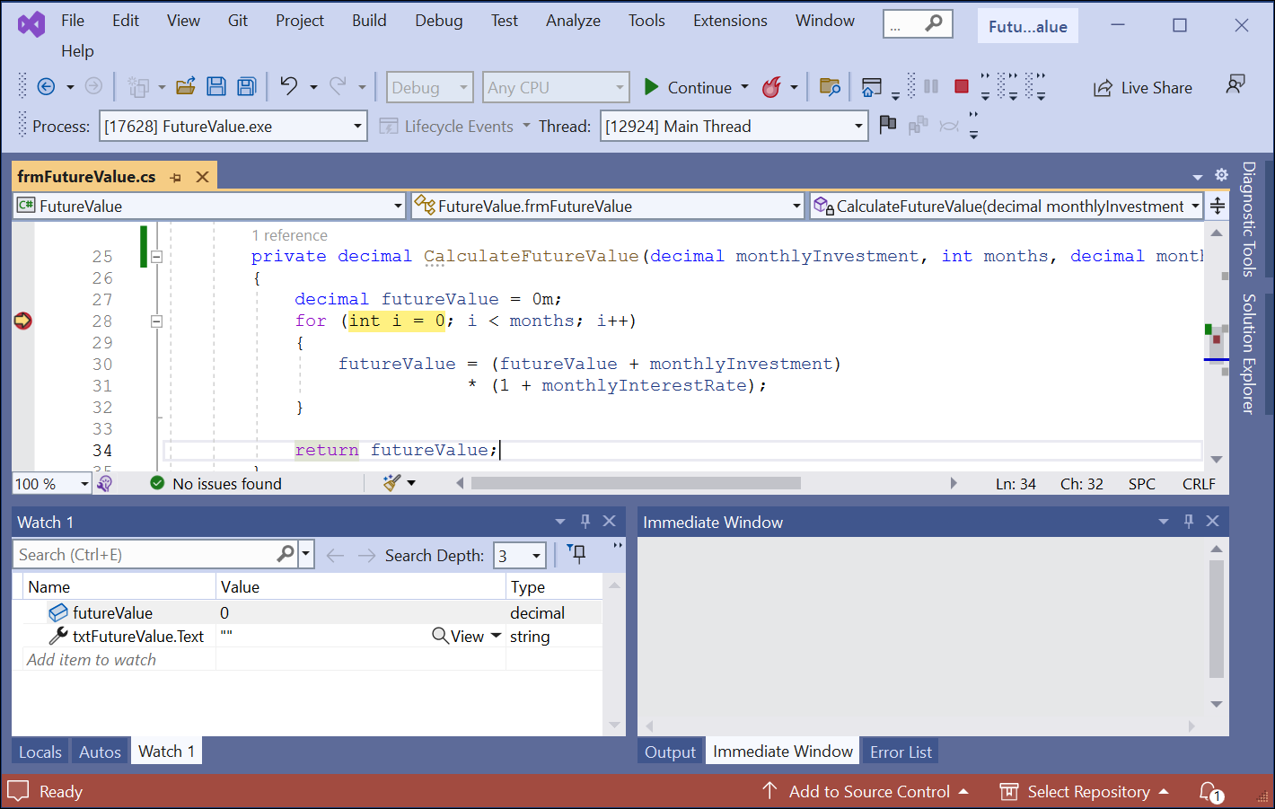
A Watch window

Slide 14
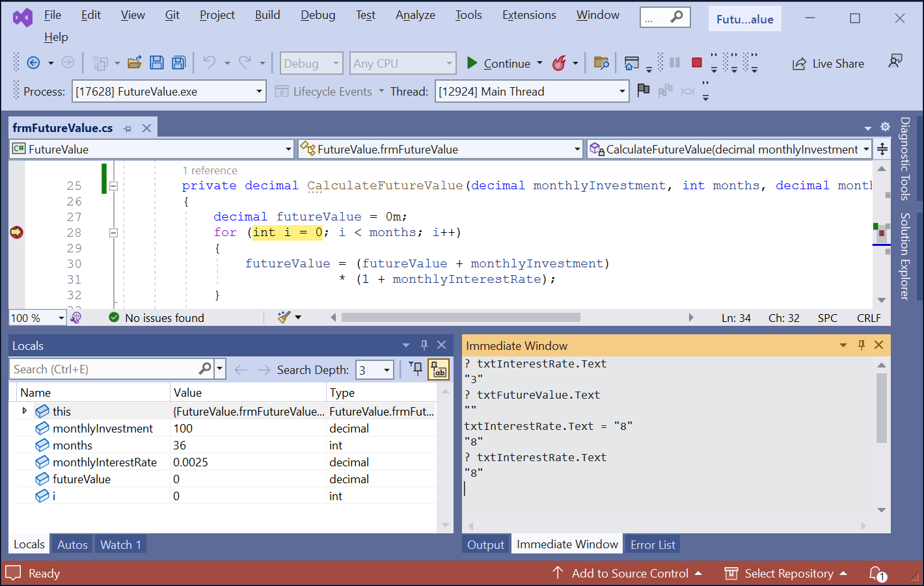
The Immediate window

Slide 15
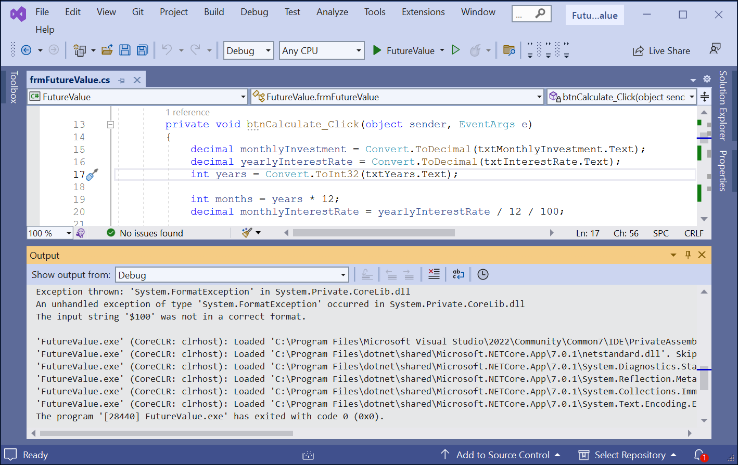
An Output window that shows debug information

Slide 16
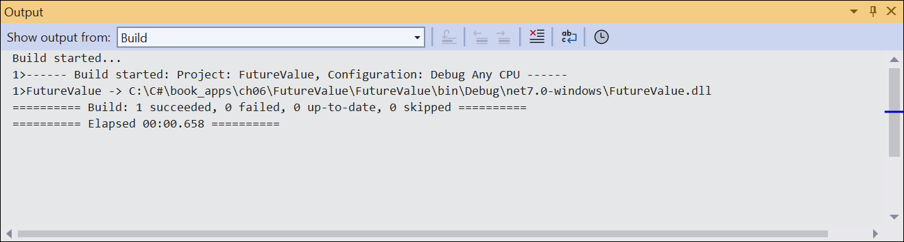
An Output window that shows build information

Slide 17
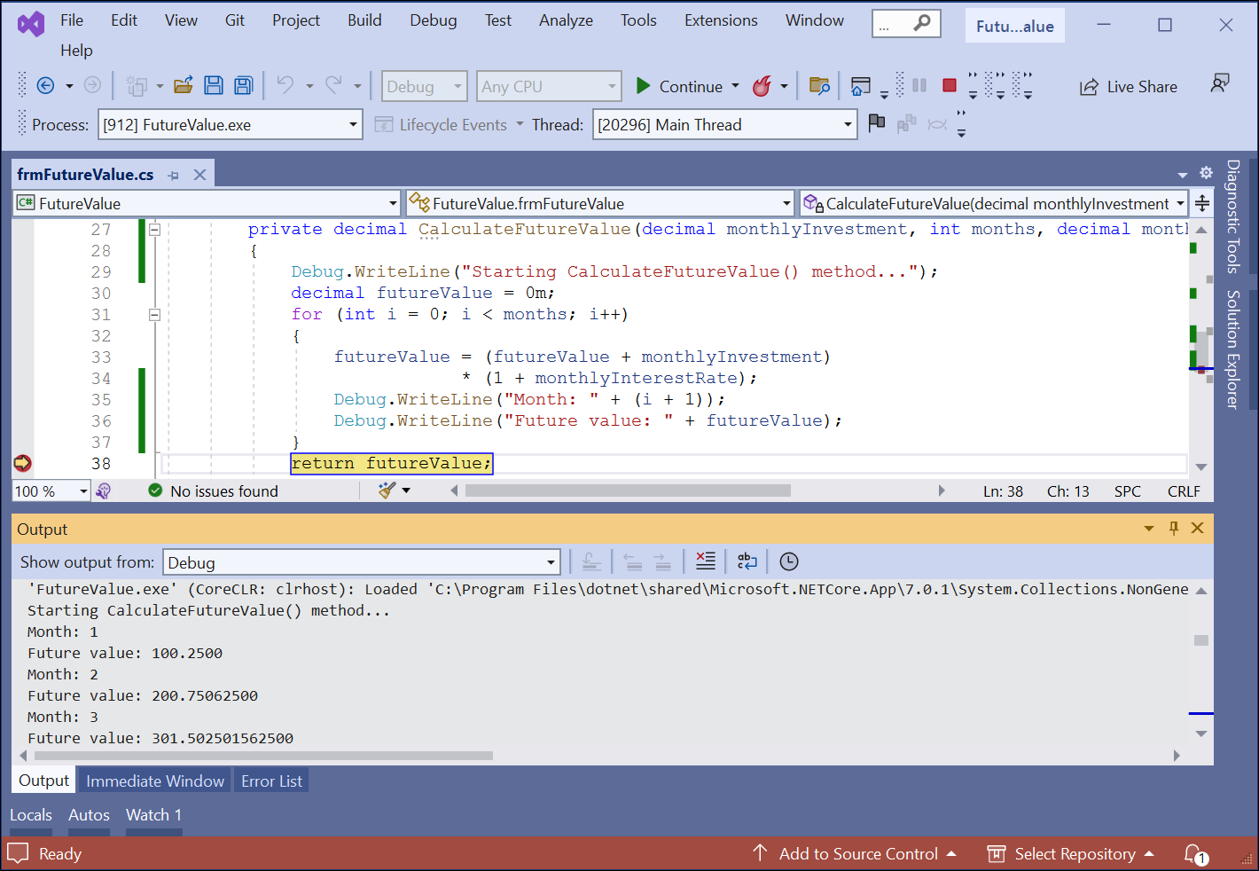
An Output window with debugging information

Slide 18
Three statements that write data to the Output window
Debug.WriteLine("Starting CalculateFutureValue() method");
Debug.WriteLine("Month: " + (i+1));
Debug.WriteLine("Future value: " + futureValue);

Slide 19
Code that uses an if statement to control when data is written
if ((i+1)%12 == 0) // every 12 months
Debug.WriteLine("Future value: " + futureValue);

Slide 20
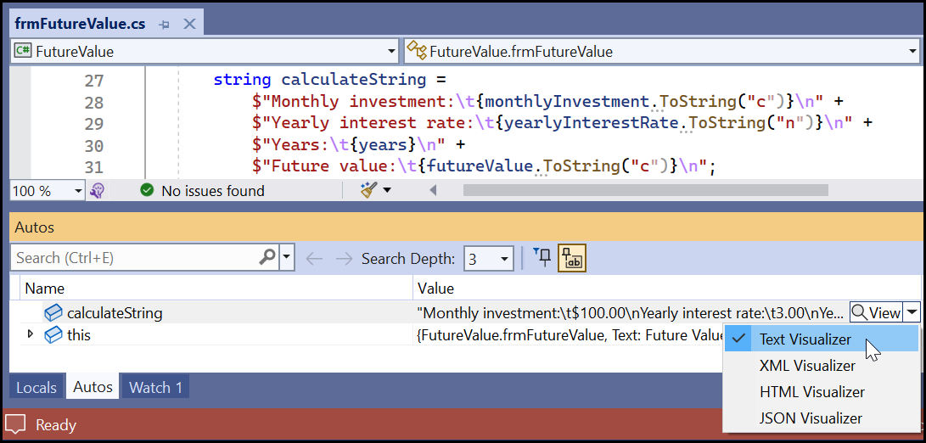
The Visualizer drop-down menu for a string in the Autos window

Slide 21
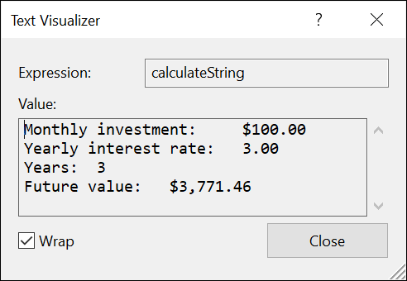
The Text Visualizer dialog

Slide 22
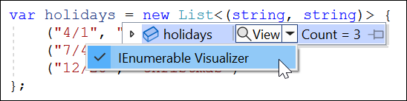
The Visualizer drop-down menu for a collection in a data tip

Slide 23
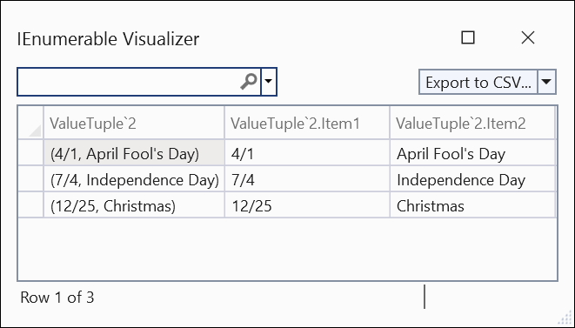
The IEnumerable Visualizer dialog

